Slide 1
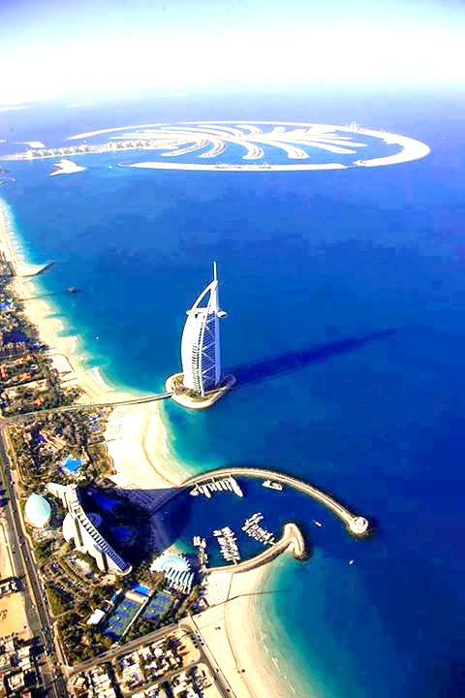

WELCOME
TO
the presentation
Nurul Momen
Senior Teacher(English)
Sherhsah Colony Dr: Mojharul Hoq High School,
Baizid Boastami, Chittagong

Slide 2

English For Today
Class Nine
Duration:50 minutes

Slide 3
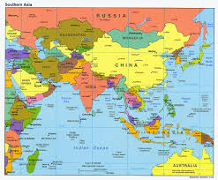

Look and say
The map of India

Slide 4
INDIA
:Unity within diversity
Unit:6 lesson: 4
Page:96

Slide 5
Learning out come
After this lesson, the learners will be able to-
  Read , summarize and comprehend the text.
  Ask and answer question
  Write a letter about the passage

Slide 6
Let’s be introduced with some difficult words
Diversity
(variety বৈচিত্রতা )
Ocean-
(bigger than sea মহাসাগর)
Bay
(smaller than sea উপসাগর )
Flourish
(Prosper/ develop উন্নতি করা)
Configuration
(External pattern বাহ্যিক আকার )
Unification
( unity/ form to one একত্রিকরণ)

Slide 7
Ancient-
(Very old)
Disintegration-
(Separation into integral part)
Expansion-
(Enlargement-প্রসারণ )
Patriotic
(Love for country দেশপ্রেম )
Restore
(Rebuild পুনরুদ্ধার করা )

Slide 8
It’s area about
3,287,590
square kilometers
INDIA
INDIA
The
7th largest country
in the world

Slide 9
China
Nepal
Bhutan
Pakistan
INDIA
A r a b i a n S e a
Bangladesh
Myanmar
North
B a y o f B a n g l e
West
East
I n d I a n O c e a n
south

Slide 10
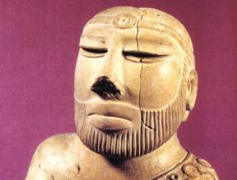
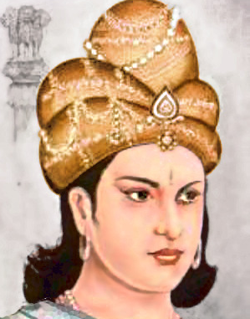
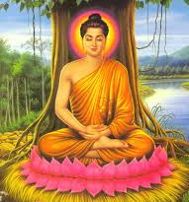
The Indian history begins with coming of Aryans
The unification of India under Ashoka in 5th century
At that time Buddhism spread in many parts of India

Slide 11
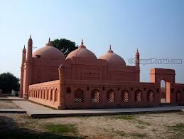
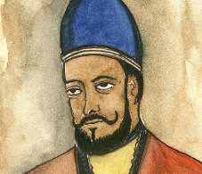
in 8th century Islam came to India first time
established in 11th century
In 1206 Qutub Uddin Aybek formed Delhi Sultanate
In 1526 Mughal Empire
Qutub Uddin Aybek

Slide 12
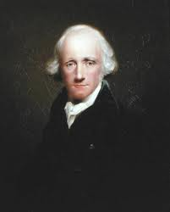
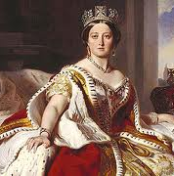
in 17th century the Europeans came to India .
East India Company appointed Warren Hastings 1st Governer General of India.
Queen Victoria.
In 1876 India came under British rule completely.
They ruled nearly two hundred years

Slide 13
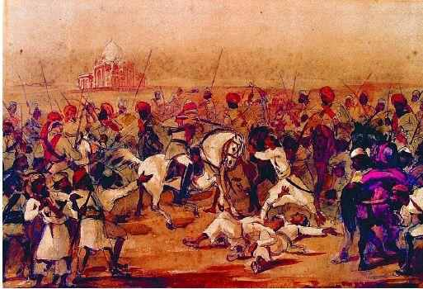
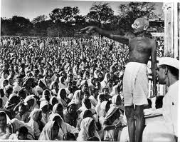
মহাত্মা গান্ধী
Through a series of heroic struggle India got independence in 1947.

Slide 14
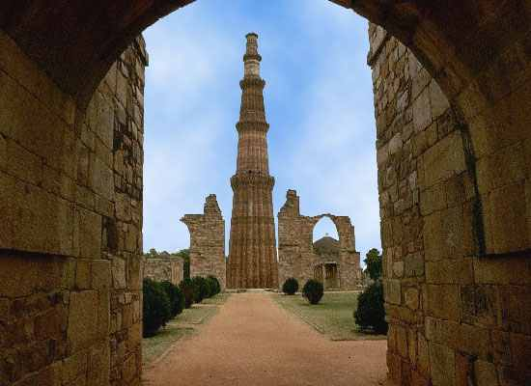
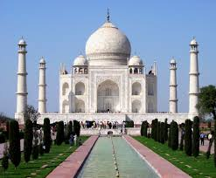
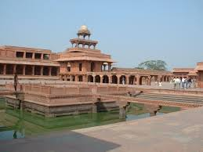
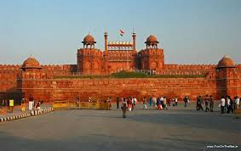
India has many tourist attraction places
Taj Mohol
Qutub Minar
Fatehpur Sikri
Red Fort

Slide 15
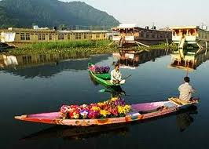
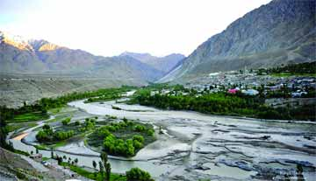
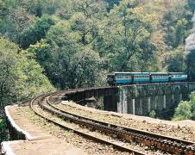
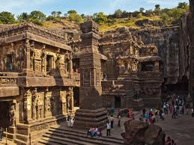
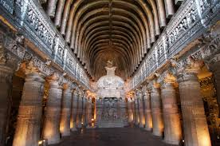
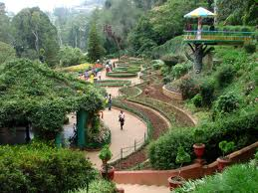
Paradise on earth
Kashmir
Different places and caves have been explored
Nilgiri
Ellora
Ajanta
Ooty

Slide 16
Pair Work
Discuss the passage with your partner and Write down Indians history & some important places

Slide 17
Evaluation
Try to answer the following –
Which countries are in the south of India?
What is the capital of India?
Who established the Delhi Sultanate?
When did India get independence?
When did Islam come first in India?

Slide 18
Home work
Make Short Paragraph mentioning Indian’s ancient culture, it’s independence and many tourist attractions

Slide 19

Thanks

